Slide 1
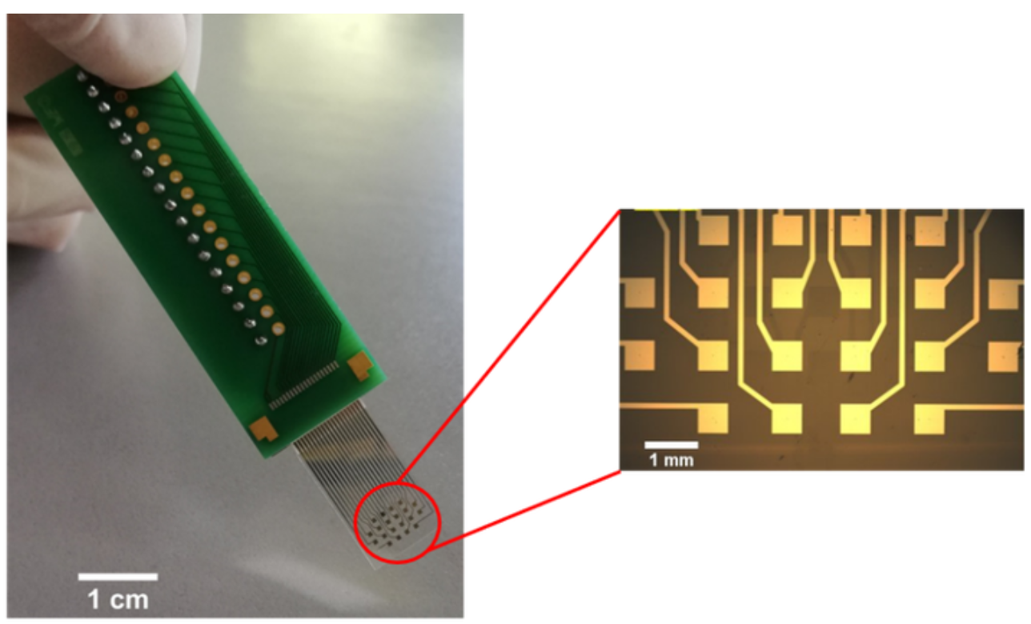
Question 1 – Design a workflow to immobilize three different kind of thiolated ssDNAs onto the gold microelectrode array in a certain pattern.
Question 2 – You have the following surface functionalization choice:
a) Hydrophobic SAM; b) Negatively charged SAM
c) PEG-polymer brush; d) Negatively charged polymer brush
e) Zwitterionic polymer brush
How does the protein adsorption/Vroman effect on these surfaces differ from each other?
Give some application example of each method.
50 µm
Question 3 – Design a protocol to fabricate microfluidic chip where water flows only in designed pathways with no physical channels. No limitation of substrate material.

Slide 2
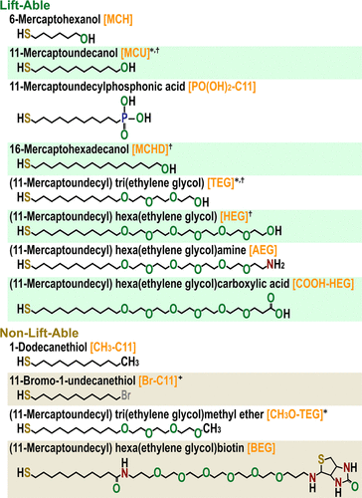
Question 1
Direct Microfluidic patterning
Microcontact printing for No.1 → Direct surface assembly of No.2 → Chemical lift-off lithography to clear the space for No.3, then binding
……
Advancing Biocapture Substrates via Chemical Lift-Off Lithography
Huan H. Cao, Nako Nakatsuka, Wei-Ssu Liao, Andrew C. Serino, Sarawut Cheunkar, Hongyan Yang, Paul S. Weiss, and Anne M. Andrews
Chemistry of Materials 2017 29 (16), 6829-6839
DOI: 10.1021/acs.chemmater.7b01970

Slide 3
Question 2
Hydrophobic SAM
Strong adsorption → fast formation of a hard corona.
Rapid displacement dynamics (Vroman effect strong).
High denaturation probability.
PEG Brush
Minimal adsorption → weak or negligible Vroman effect.
Fast-exchanging “soft corona” at most.
Proteins do not bind strongly enough for a hard corona.
Negatively Charged SAM/Polymer Brush
Minimal bind of negatively charged proteins due to electrostatic repulsion.
Some positively charged proteins may adsorb strongly.
Vroman effect occurs but is muted and more selective.
Zwitterionic polymer brush
Better antifouling effect than PEG brush

Slide 4
Question 3 – One example
Microcontact printing/ microfluidic patterning to create hydrophilic SAM of fluid channel pattern
Hydrophobic polymer brush on the rest part (Grafting-from approach preferred)

